Slide 1




Mechanical Assembly for NUV CCD Camera Telescope
Alejandro Romero-Lozano
Dr. Erika Hamden
2023 Arizona NASA Space Grant
Statewide Student Research Symposium
Notes:
My name is Alex Romero-Lozano and I am an electrical engineering student at the university of Arizona. Through the support of Arizona Space Grant I worked with Dr. Erika Hamden on the Mechanical Assembly for a Near UV CCD Camera Telescope.

Slide 2

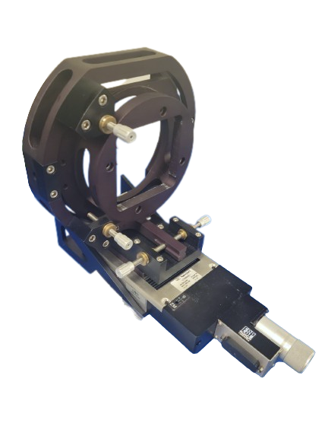
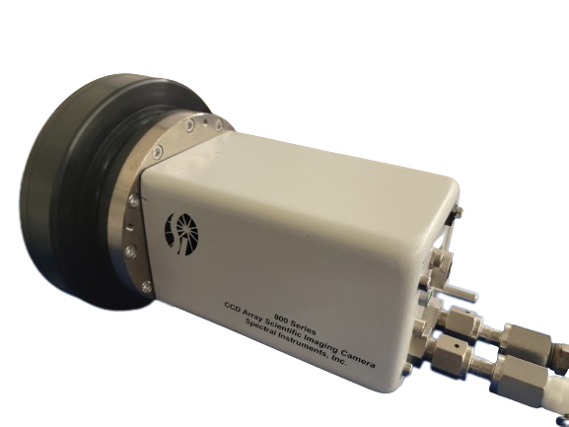
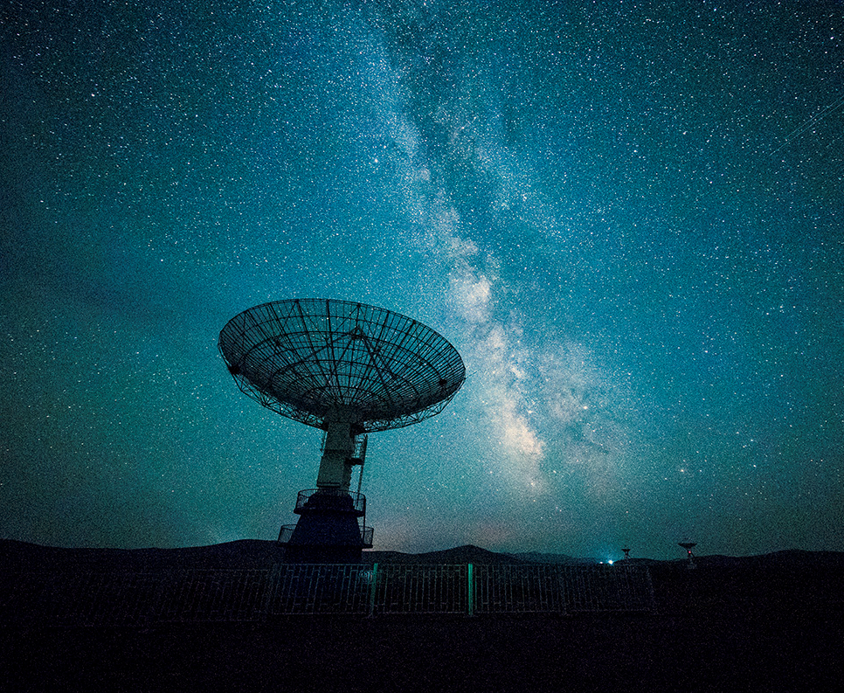
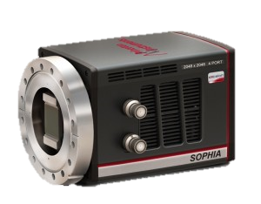
Background
Super-Lotis Project
Fully Automated Robotic Telescope
Measure Gamma Ray Bursts (GRBs)
800S Spectral Instruments
Super-Lotis Update
Update to modern CCD Camera
Replace some capability of aging Swift Mission
Sopia X0 2048
Existing Mechanical Assembly
Notes:
The super-lotis project is a robotic telescope on top of Kitt Peak. It was first in operation in 2000 and it was fully automated robotic assembly which was connected to the Gamma-ray Burst Coordinates Network which a system that distributes the location of gamma ray bursts. Super-Lotis on kitt peak would analyze the location of gamma ray bursts by moving itself to the coordinates it received from the gamma ray network. Throughout the years, the filters and the field of view of the telescope have been changed, improving the ability to see. The super lotis project is currently measuring around 60 targets every year.
The Super-Lotis project is being updated to switch the 800s spectral instruments Camera which was produced in 2002. The new camera called, which is the Sophia X0 2048, has 4 times as many pixels as the old camera. Launched in 2004, the Swift Mission which is a space-based telescope which measures gamma ray bursts at a very high sensitivity.
With the Sophia Camera there have to be a lot of modifications to the hardware.

Slide 3


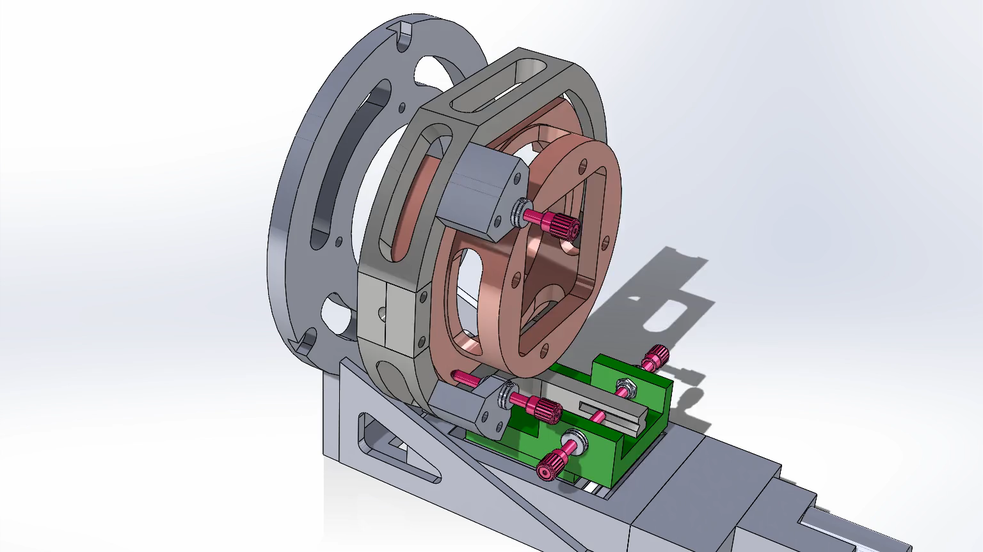
Problem Statement
Filter Interface
Camera Mount
Criteria
Ultra-High Vacuum (UHV) Port
Viewport
Shutter
5 axis of rotation
Constraints
Low-cost
Camera Geometry
Existing Mechanical Assembly
Notes:
The very first step was to digitize everything I could. I used Solidworks to create a fully function 3d model of the existing system. I used a caliper and carefully measured each part. I also double checked the digital model by measuring references across multiple parts. With this method, this articulated model was produced. Having the model articulate is extremely useful during the development process as I can check interference and how much freedom the assembly has very quickly. The amount of space I have to design is very limited. Ill just play that video.
I then split up the problem into criteria and constraints. The new camera needs to be operated in very high vacuum (approximately 10^-6 torr). The previous camera had a port on the back to provide vacuum. An external viewport, which is the basically a glass cover for the sensor of the camera
new camera the vacuum needs to be in front of the camera which provides an issue because there is not a lot of space between the camera mount and the filter interface
In order to keep the same functionality mechanically, the camera has to have 5 axis of freedom. There does not have to be a lot of freedom as the assembly only has to be constrained to the robotic assembly.

Slide 4
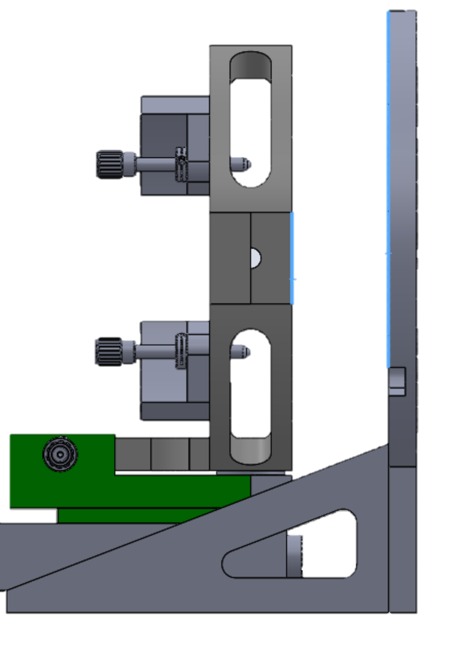
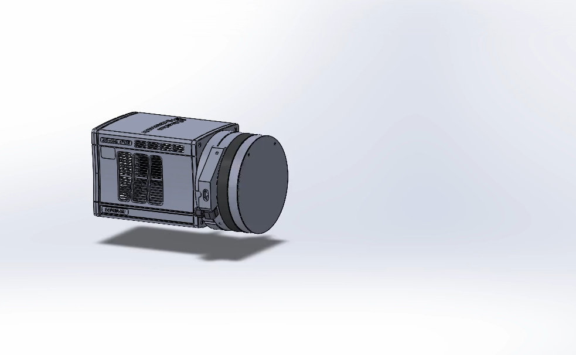
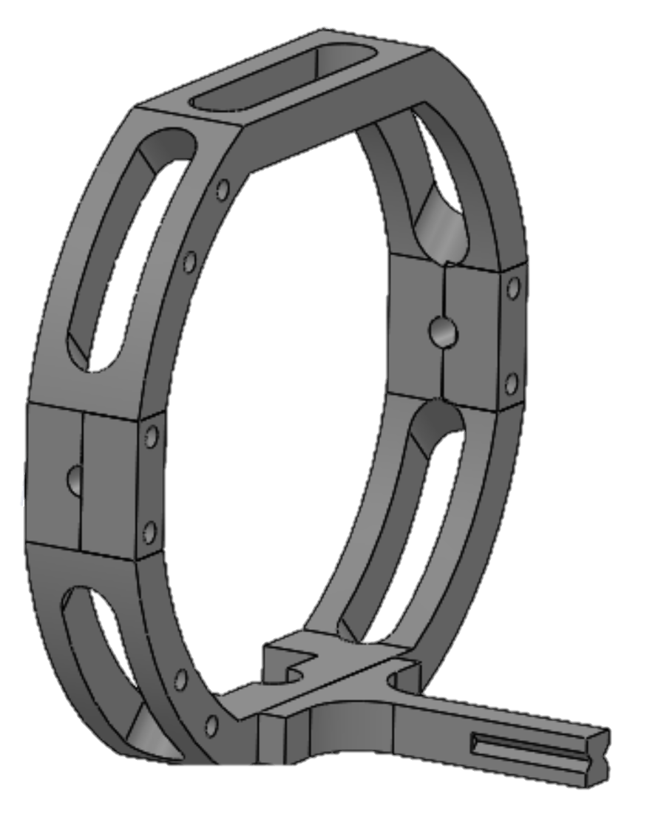
Issues
~45mm
Size Issues
Shutter Geometry
Thickness of off-the-shelf Viewport
Vacuum Port Interference
with Outer Ring
Outer Ring Size
Given Space
1st Attempt Full Stack
Outer Ring
Notes:
Shutter Geometry
-the old shutter was a uniblitz VS45 (made in 2004). It was so old that when I asked the manufacturer about it he was shocked that it was still functional. Geometry wise the shutter’s size was large so that it fit directly over the bolt holes that are need for the camera. This is bad

Slide 5
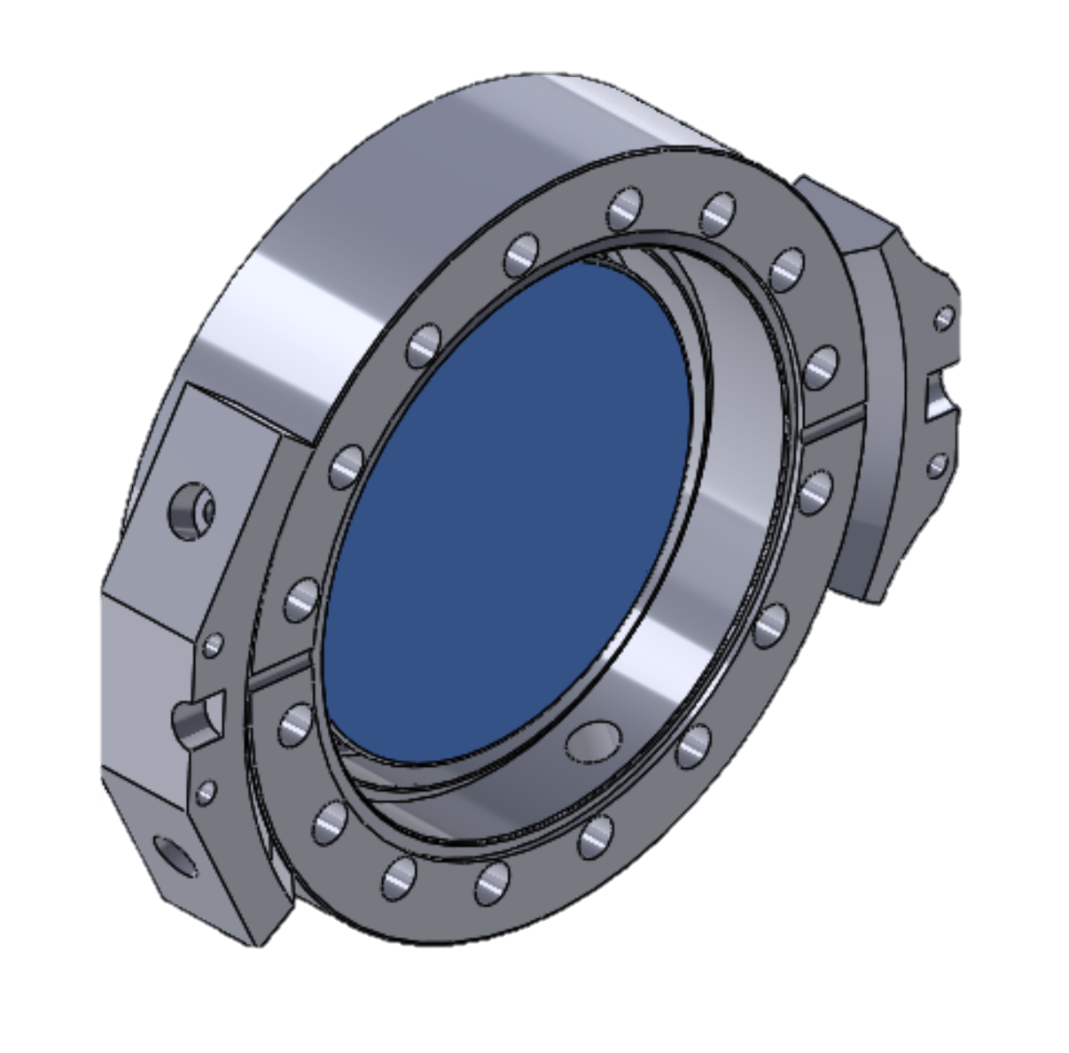
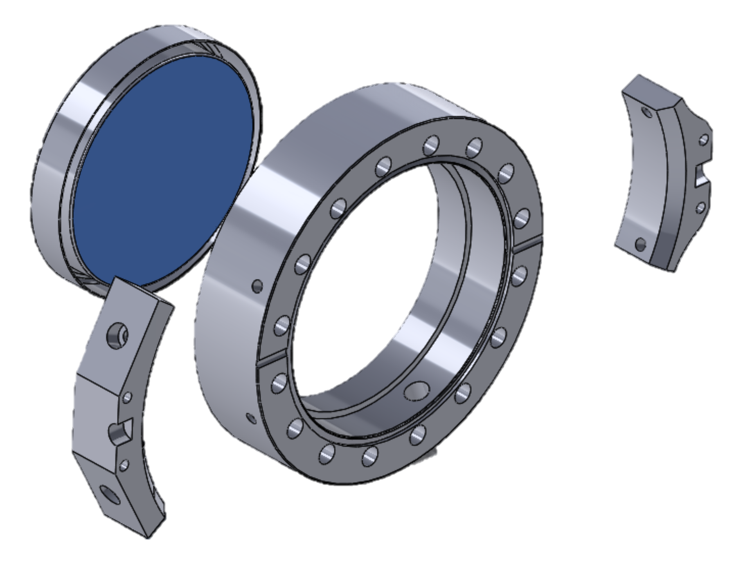
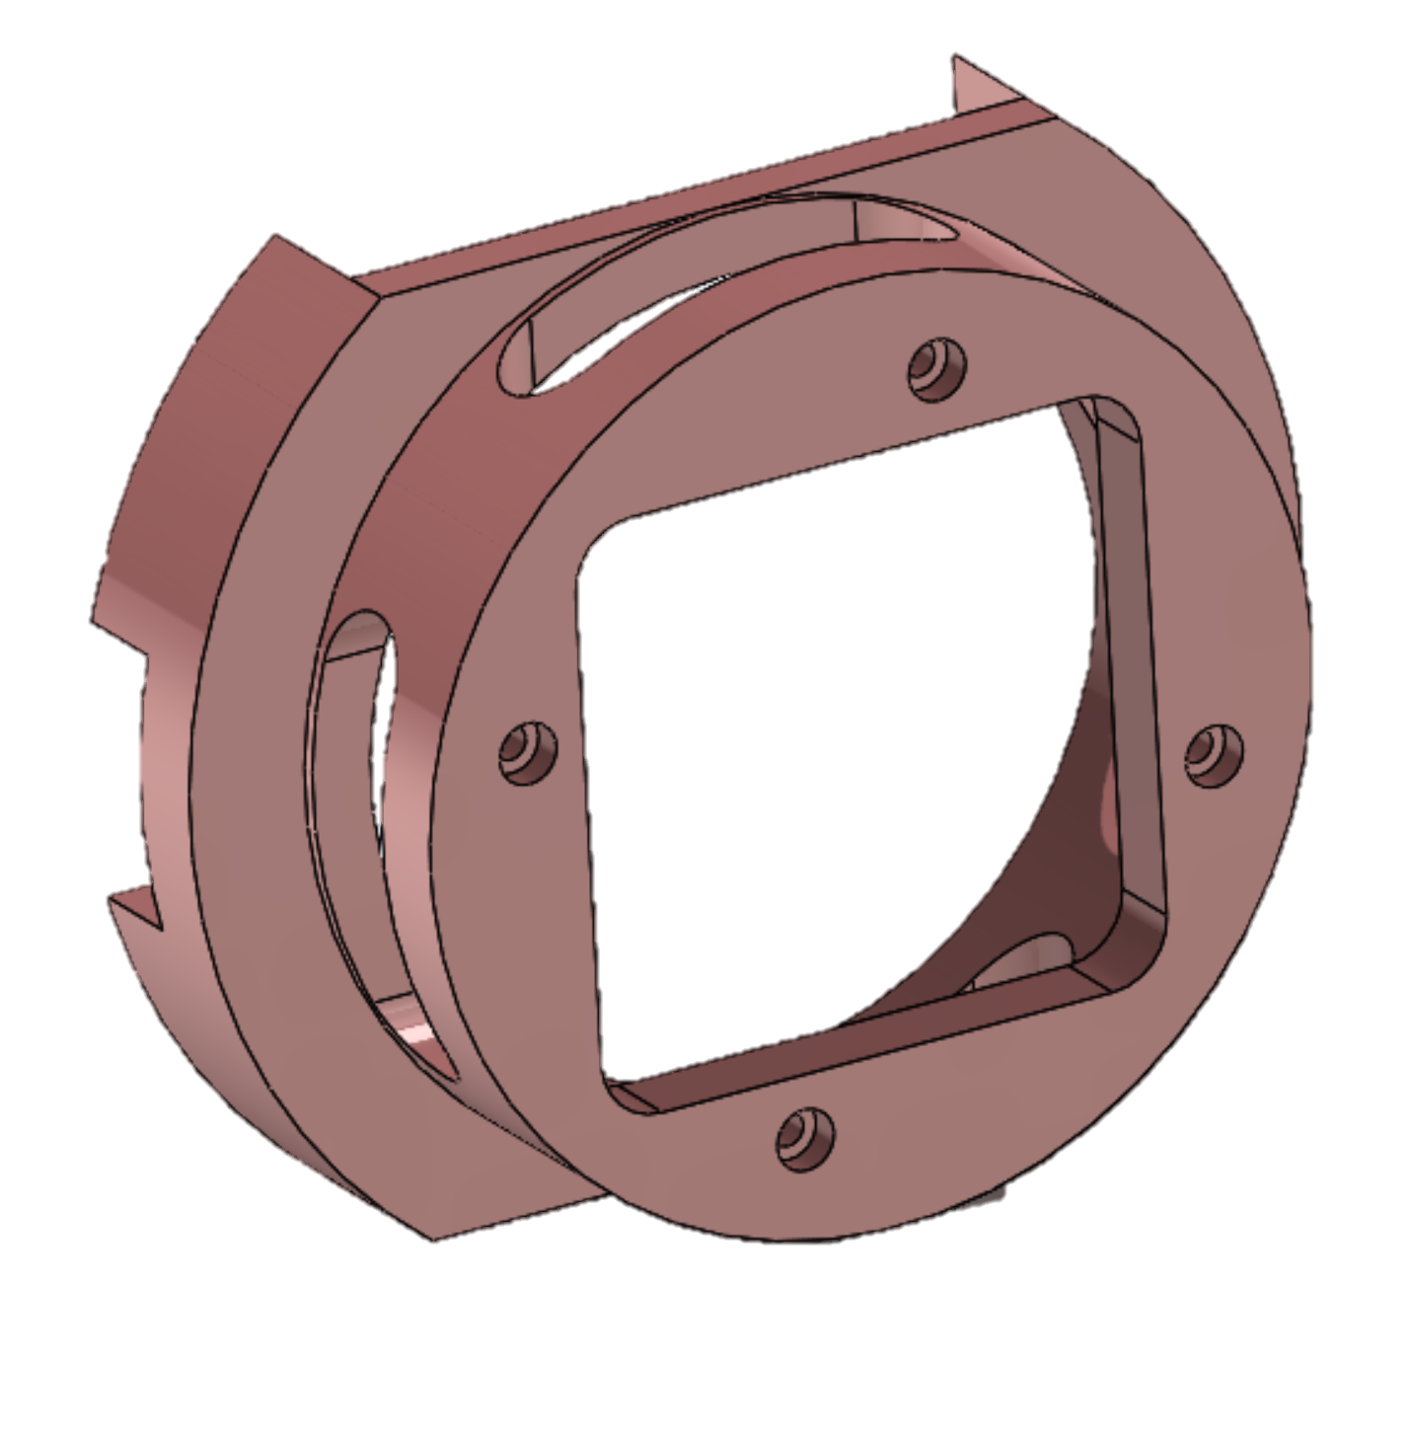
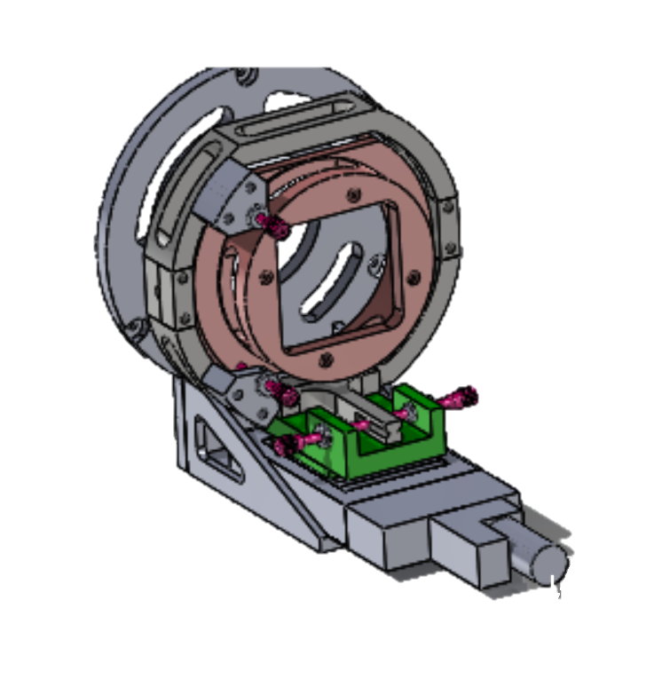
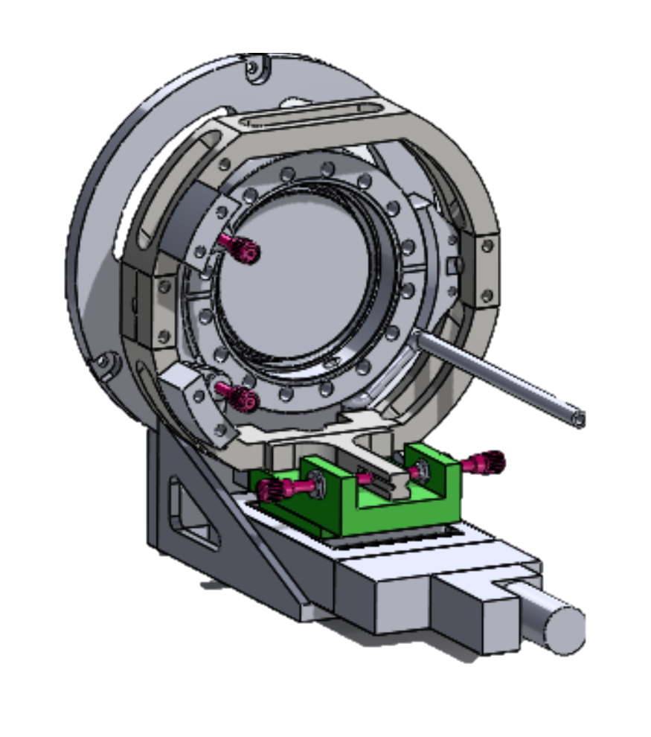
Solution
Single piece for vacuum and viewport
Custom Viewport glass optimized for NUV operation
Optimized for Manufacturability
Minimal Changes to Existing Assembly
Existing Mount
New Mount
Existing Assembly
New Assembly

Slide 6
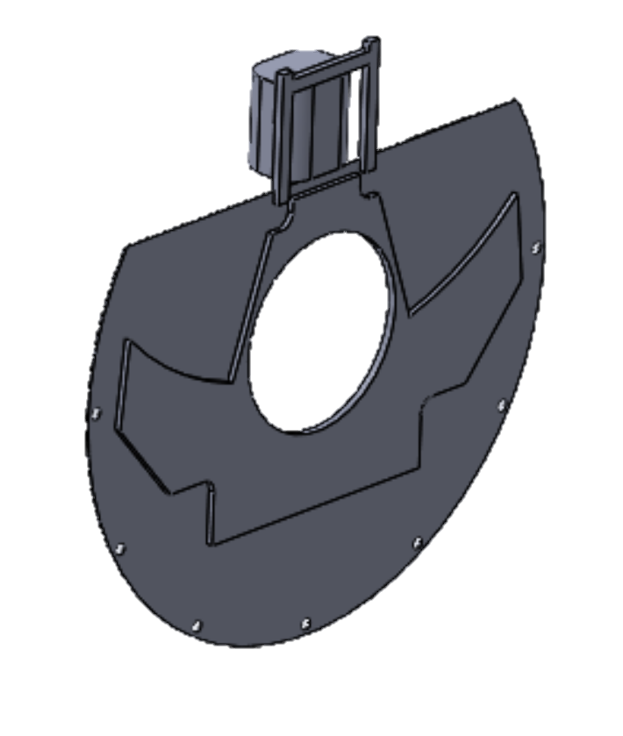
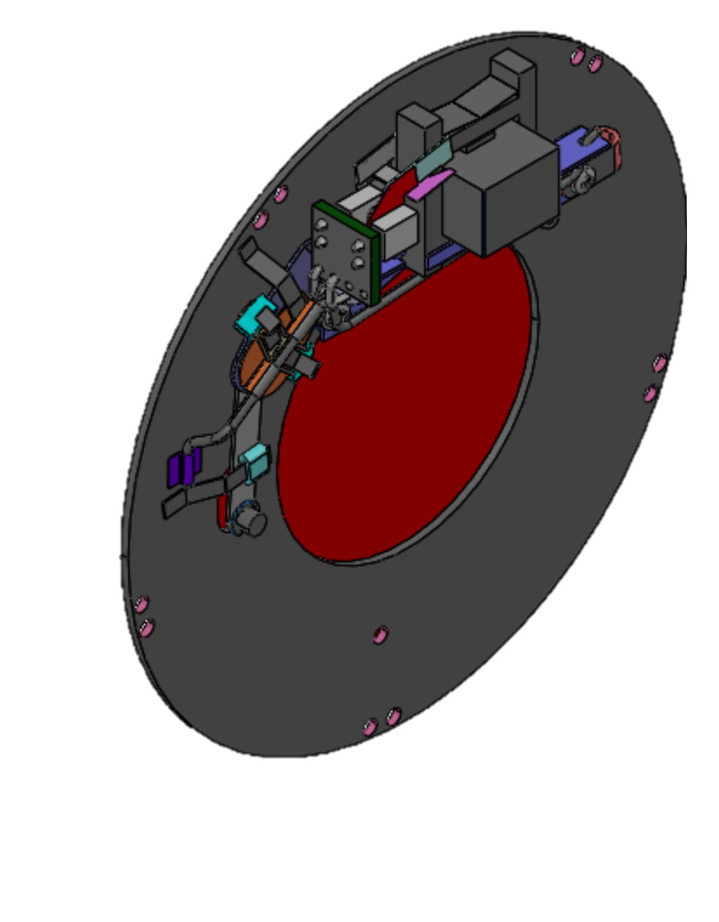
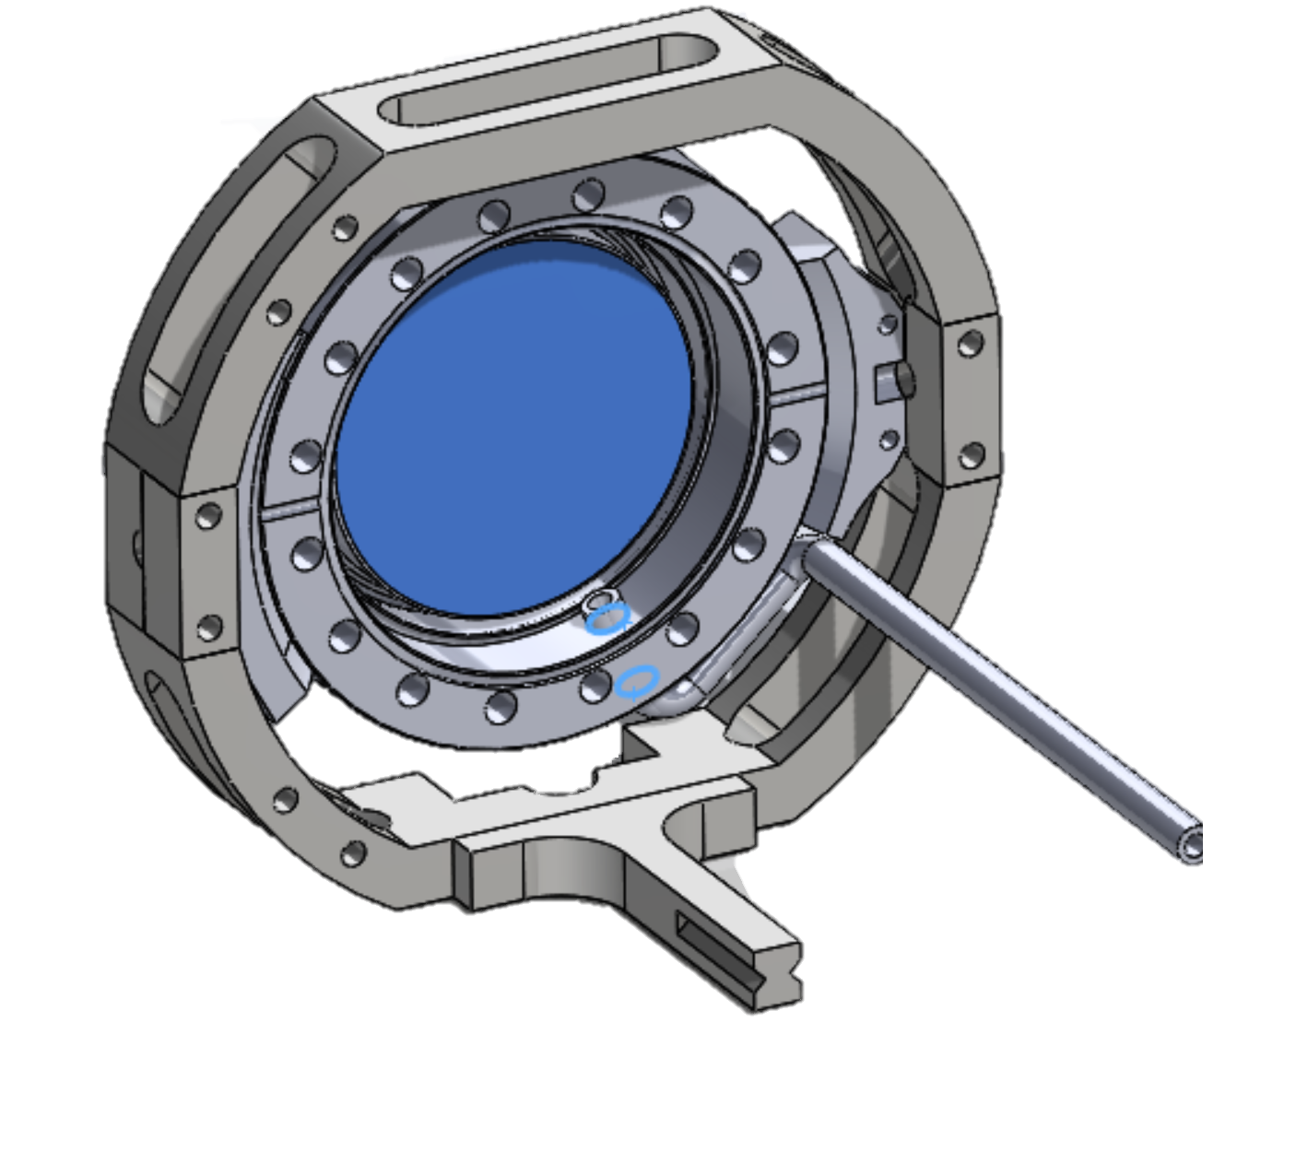
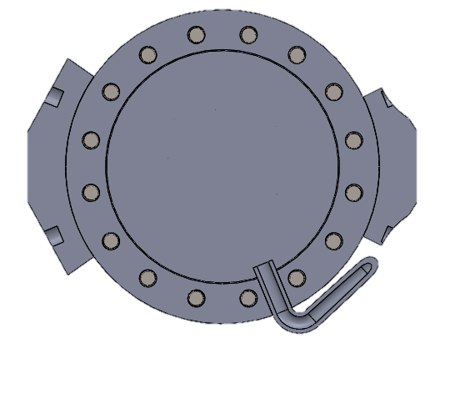
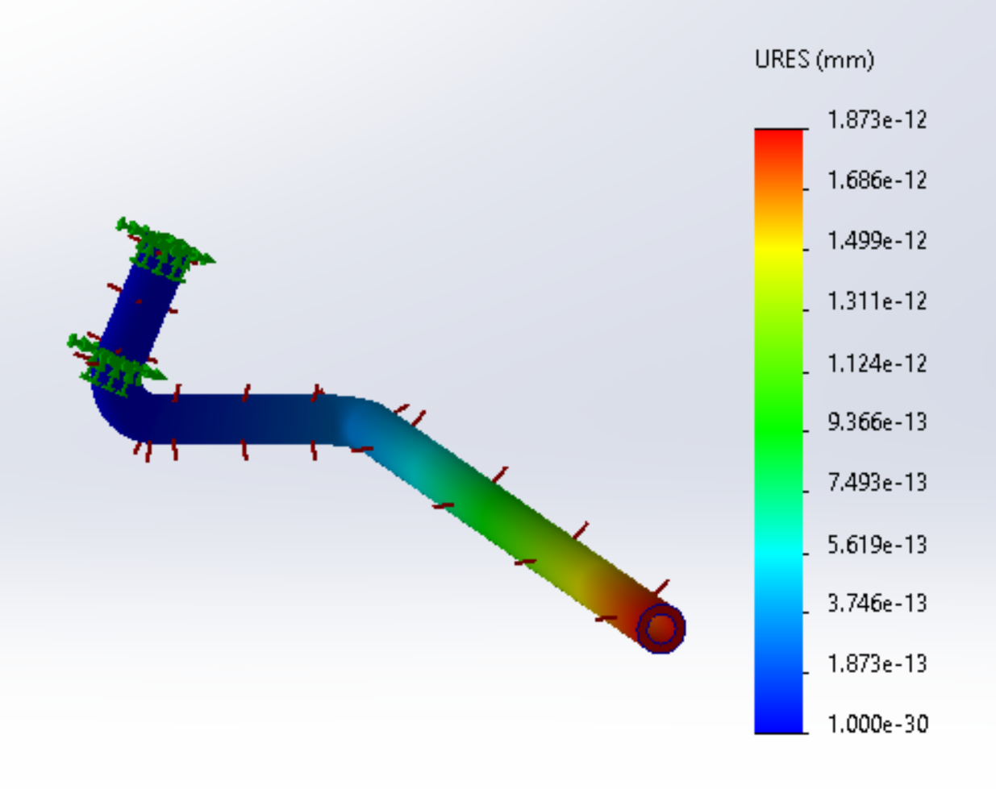
Solution cont.
Reliable and compact modern Shutter
Welded Steel Bent Tube Provides Ultra-high vacuum
VS45
CS45
Mount Cross-section
Assembly with Tube
Tube FEA

Slide 7
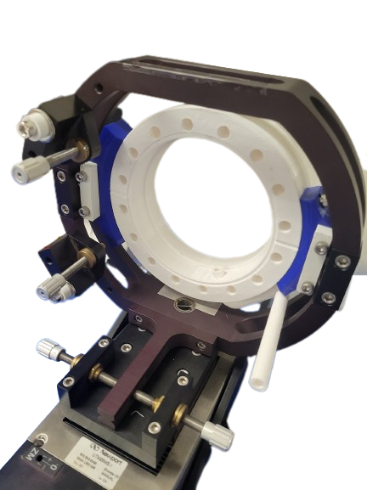
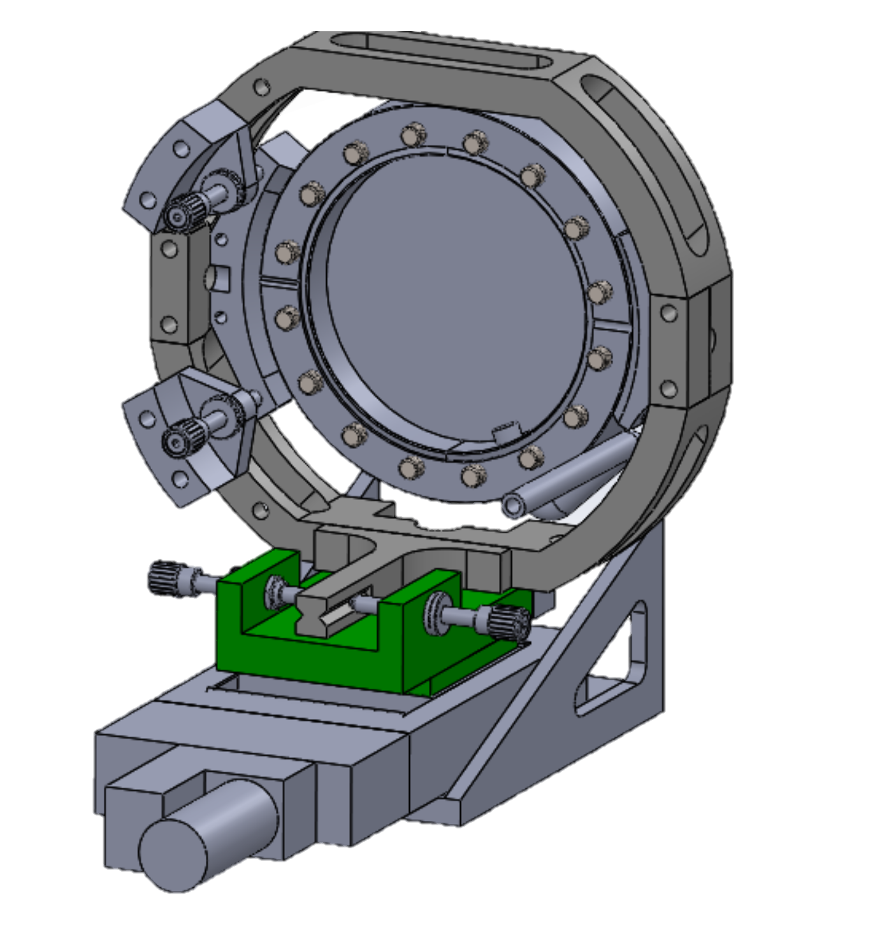
Conclusion
Next Steps
Quote for manufacture of Assembly in progress
Installation on Kitt Peak
General Design
Low Cost
Adaptable
New Assembly
Prototyped Assembly

Slide 8

Special thanks to
Dr. Erika Hamden
Dr. Peter Milne
Aafaque Khan
Harry Bradley
Ipek Kerkeser
Department of Lunar and Planetary Sciences
Arizona Space Grant

Slide 9
Thank you

